Slide 1


Slide 2


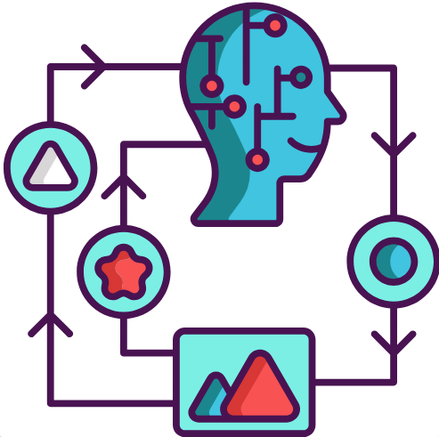
INTRODUCTION TO MACHINE LEARNING
Machine learning is a subset of artificial intelligence that focuses on teaching computers to
learn from data and improve over time without explicit programming.
Supervised Learning
Un-Supervised Learning
Reinforcement Learning

Slide 3
Use Cases:
Financial firms
Fraud Detection
Natural Language Processing
Autonomous Systems
Healthcare
Image and Speech recognition
Recommender System
Fraud Detection

Slide 4
DATA SCIENCE FRAMEWORK FOR MACHINE LEARNING
Problem Definition
Data Collection and Preparation
Exploratory Data Analysis
Model Selection and Training
Model Validation and Tuning
Model Testing & Evaluation
Problem Definition
Feature Selection & Engineering
Data Splitting
Model Selection and Training
Model Deployment
Model Monitoring & Maintanance

Slide 5
Feature Selection and Engineering

Slide 6
Data Splitting

Slide 7
Introduction to Machine Learning

Slide 8
Model selection and training

Slide 9
Model validation and tuning

Slide 10
Model testing and Evaluation

Slide 11
Model deployment

Slide 12
Model maintaince and monitoring

